Slide 1
Group 6 PROJECT ON Python for machine learning

Slide 2
Team members
M.Visweswaran [CB.EN.U4AIE20075]
Vishnu Radhakrishnan [CB.EN.U4AIE20074]
Thushit Kumar R [CB.EN.U4AIE20072]
Menta Sai Akshay [CB.EN.U4AIE20040]
Krishnan K M [CB.EN.U4AIE20031]

Slide 3
HANDWRITTEN DIGIT RECOGNITION

Slide 4
ALGORITHMS USED
KNN ( K –Nearest Neighbours)
Random Forest
NN ( Neural Network)
SVM ( Support Vector Machines)
CNN ( Convoluted Neural Network)

Slide 5
MAIN GOAL & APPLICATIONS
Handwritten Digit Recognition is used to recognize the Digits which are written by hand.
A handwritten digit recognition system is used to visualize artificial neural networks.
It is already widely used in the automatic processing of bank cheques, postal addresses , in mobile phones etc.

Slide 6
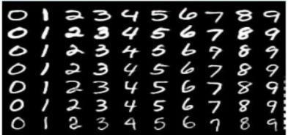
TRAINING DATASET
Training of the network is done by a dataset named MNIST dataset.
MNIST dataset has a training set of 60,000 examples
All the images in the dataset are of 28 x 28 pixels.

Slide 7
HANDWRITTEN DIGIT RECOGNITION USING knn ALGORITHM
1

Slide 8
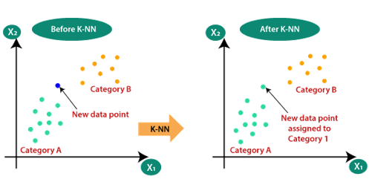
K – NEAREST NEIGHBOUR
K-NN is a non-parametric algorithm, which means it does not make any assumption on underlying data.
It is also called a lazy learner algorithm because it does not learn from the training set immediately instead it stores the dataset and at the time of classification, it performs an action on the dataset.
KNN algorithm at the training phase just stores the dataset and when it gets new data, then it classifies that data into a category that is much like the new data.

Slide 9
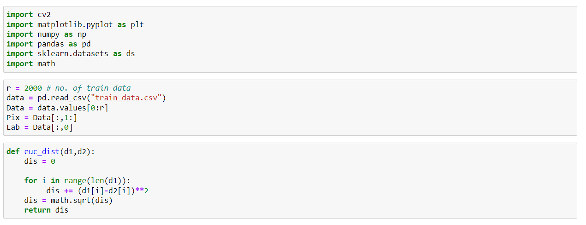
CODE

Slide 10
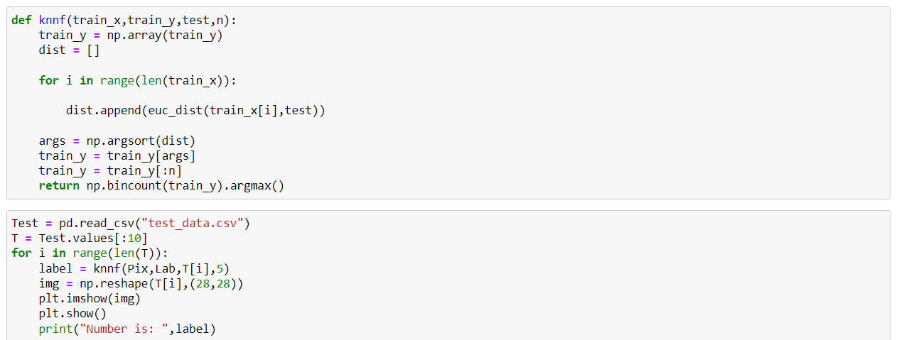
CODE

Slide 11
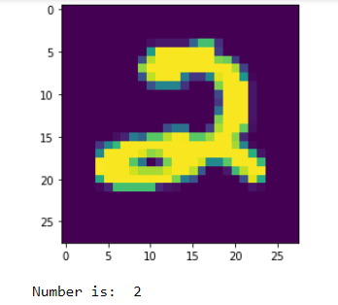
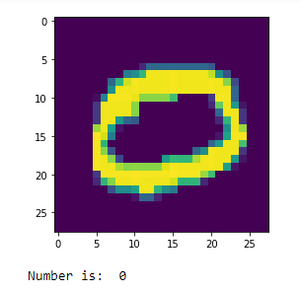
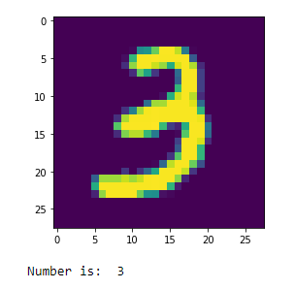
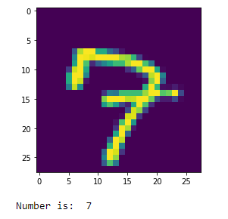
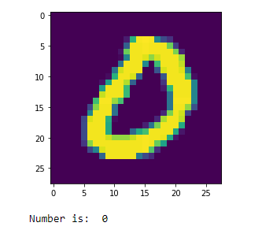
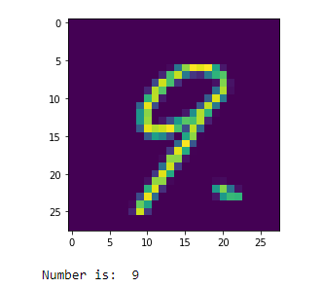
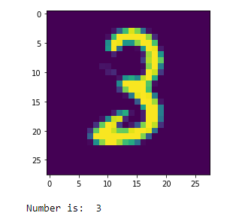
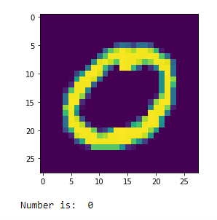
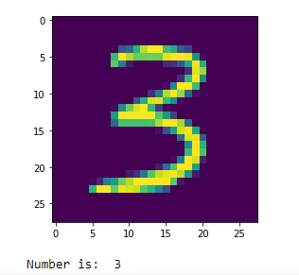
OUTPUT

Slide 12
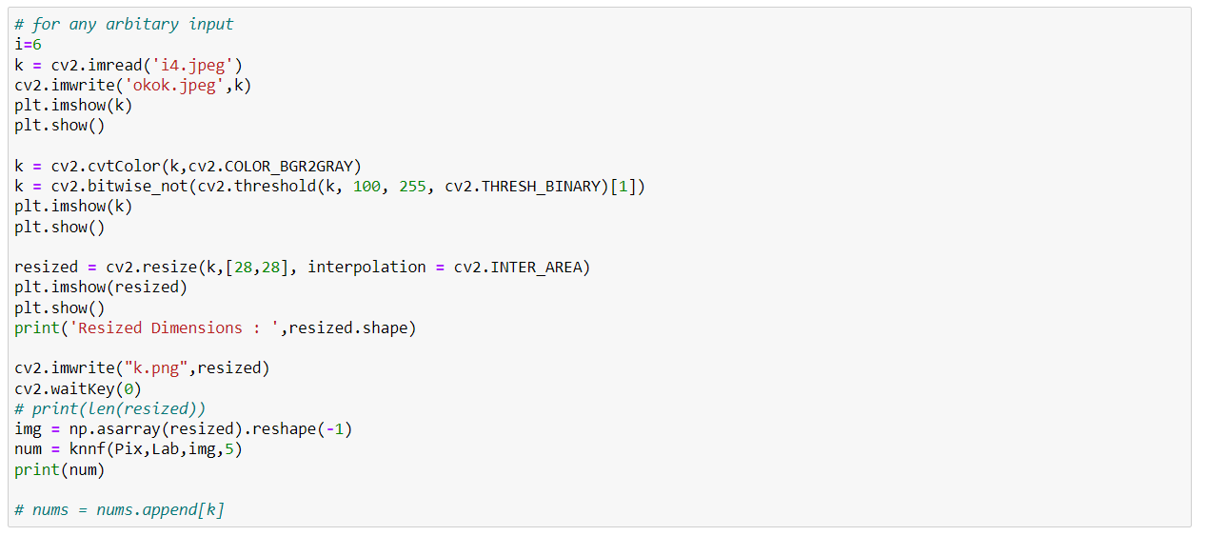
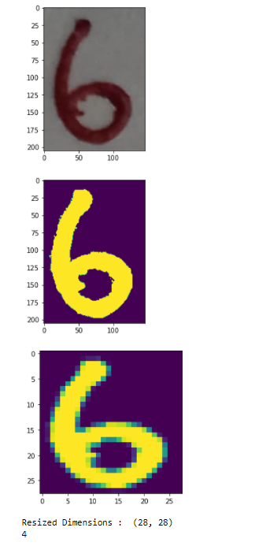
CODE

Slide 13
HANDWRITTEN DIGIT RECOGNITION USING random forest algorithm
2

Slide 14
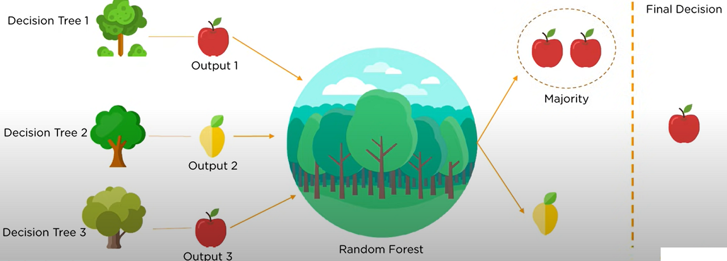
What is RANDOM FOREST?
Random forest or Random Decision Forest is a method that operates by constructing multiple decision Trees during training phase. The Decision of the majority of the trees is chosen by the random forest as the final decision .

Slide 15
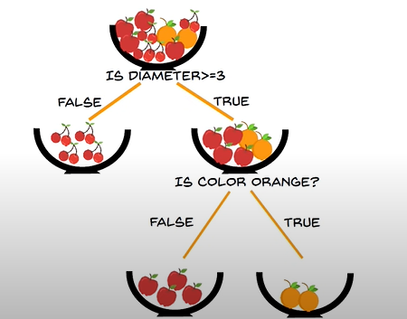
WHAT IS DECISION TREE?
Decision Tree is a tree shaped diagram used to determine a course of action. Each branch of the tree represents a possible decision, occurrence of reaction

Slide 16
Decision TREE IMPORTANT TERMS
Entropy
Information gain
Leaf Node
Decision Node
Entropy is the measure of randomness or unpredictability
In the dataset
It is the measure of decrease in entropy after the dataset is split
Leaf Node carries the classification or the decision
Decision Node has two or more branches
Root Node
The topmost decision Node is known as Root Node

Slide 17
RANDOM FOREST IMPORTANT TERMS
Bagging:
Bagging (bootstrapping + aggregating) is the usage of an ensemble of models in which each model uses a bootstrapped data set, and the predictions of the models are aggregated.
Bootstrapping:
Each tree in a random forest learns from a random selection of data points during training. The samples are drawn utilizing replacement, which implies that certain samples will be used several times in a single tree. The theory is that by training each tree on diverse samples, even if each tree has a high variation about a specific set of training data, the overall variance of the forest will be smaller, but not at the expense of increasing the bias.
Aggregation:
An overall forecast or estimate is created using random forest methods by aggregating predictions given by individual decision trees. Forecasts are made at test time by averaging the predictions of each decision tree. Bagging, short for bootstrap aggregating, is the process of training each individual learner on distinct bootstrapped subsets of the data and then averaging the predictions

Slide 18
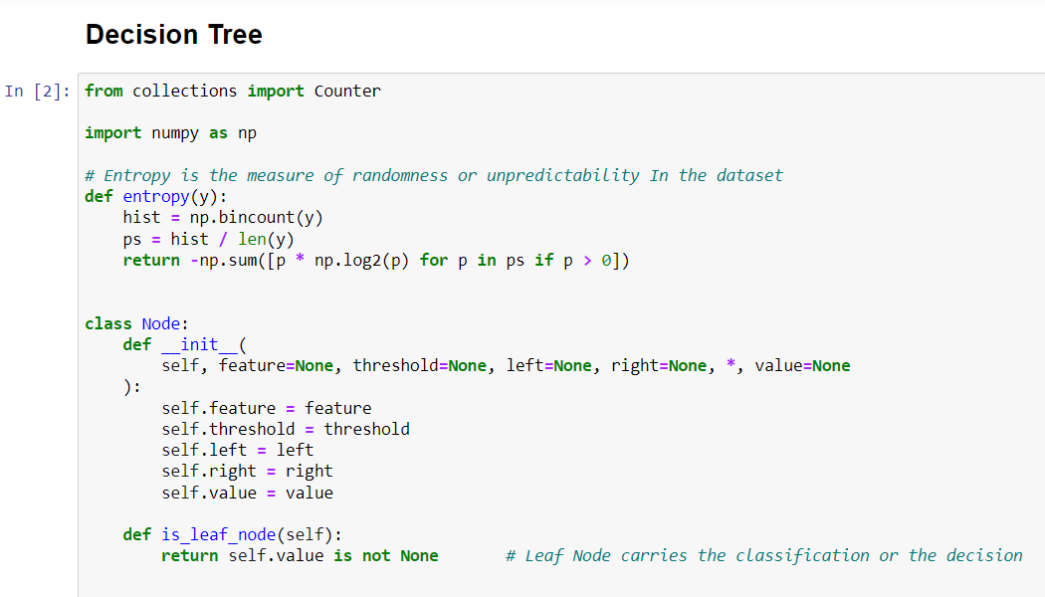
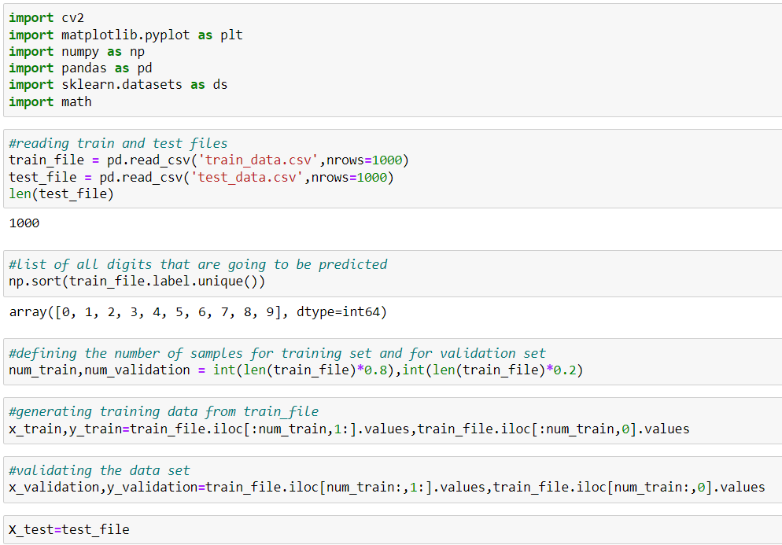
CODE

Slide 19
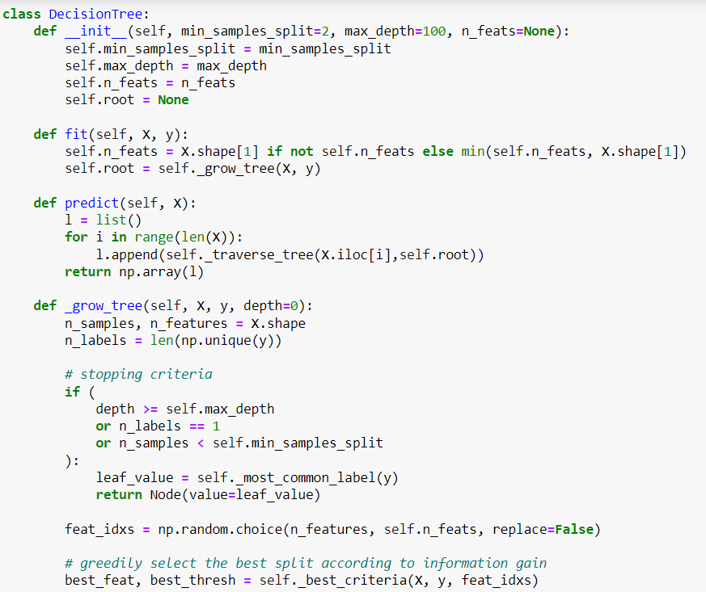
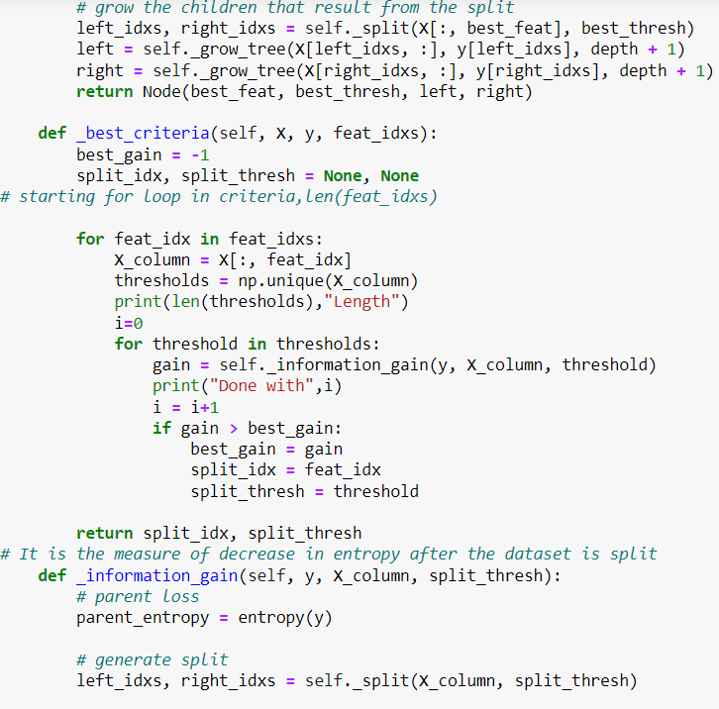
CODE

Slide 20
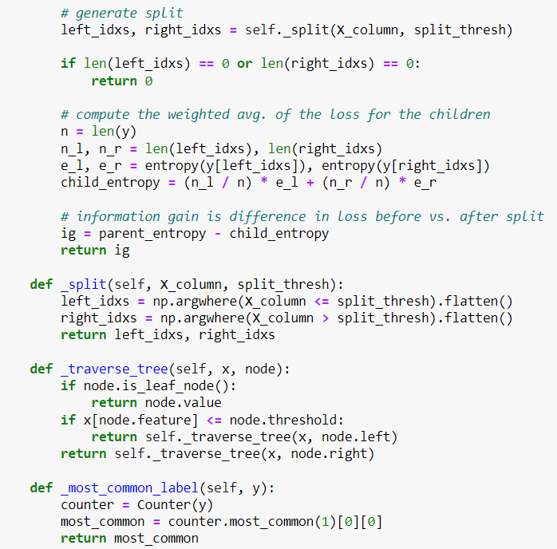
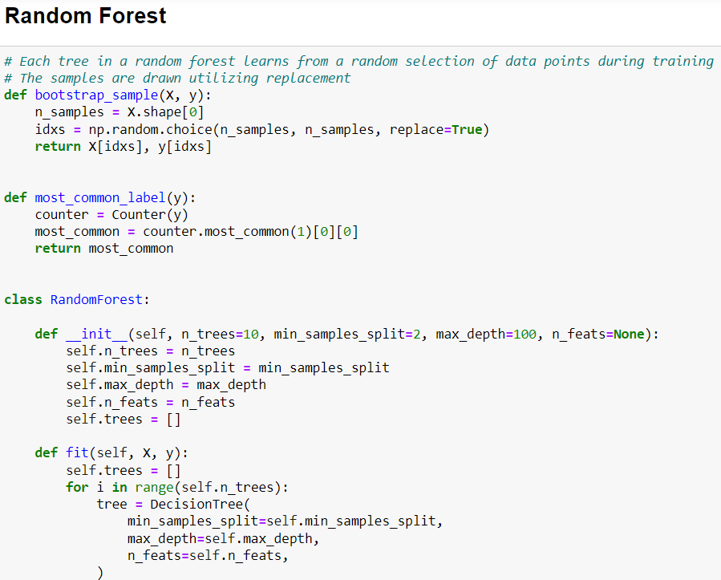
CODE

Slide 21
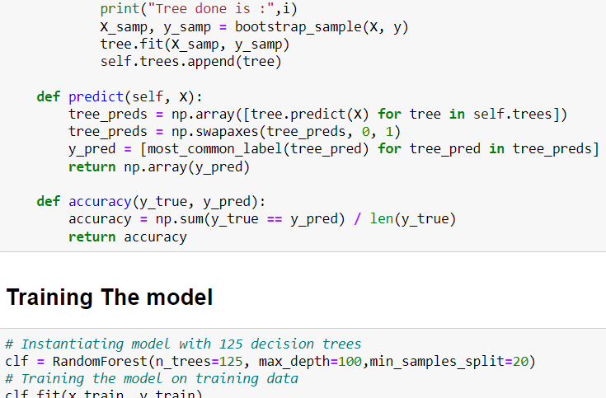
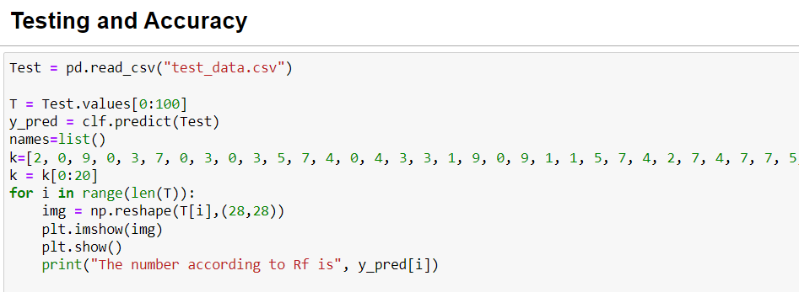
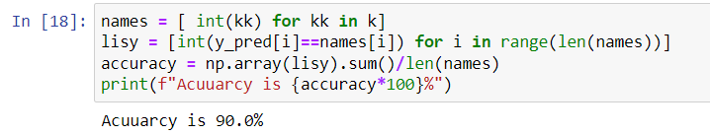
CODE

Slide 22
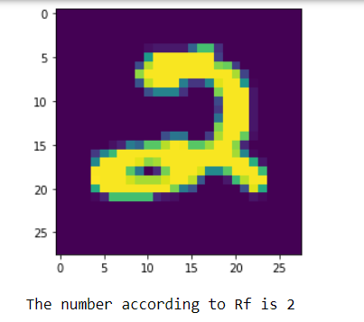
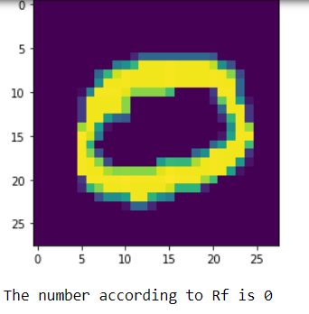
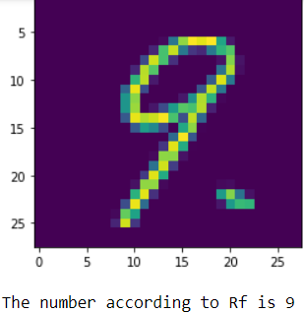
OUTPUT

Slide 23
HANDWRITTEN DIGIT RECOGNITION USING Neural Network
3

Slide 24
What is Neural network
A neural network is a series of algorithms that endeavors to recognize underlying relationships in a set of data through a process that mimics the way the human brain operates. In this sense, neural networks refer to systems of neurons, either organic or artificial in nature.
Neural networks can adapt to changing input; so the network generates the best possible result without needing to redesign the output criteria.

Slide 25
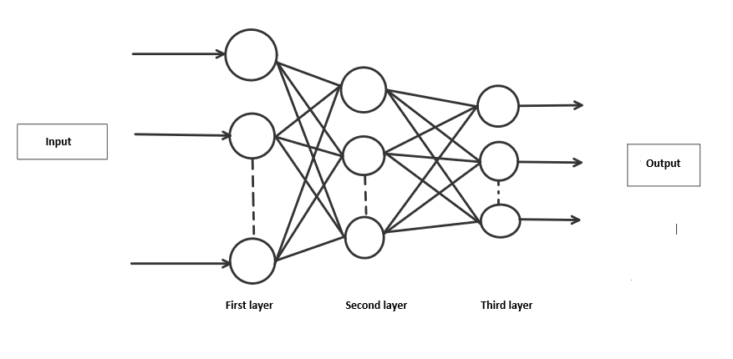

Slide 26
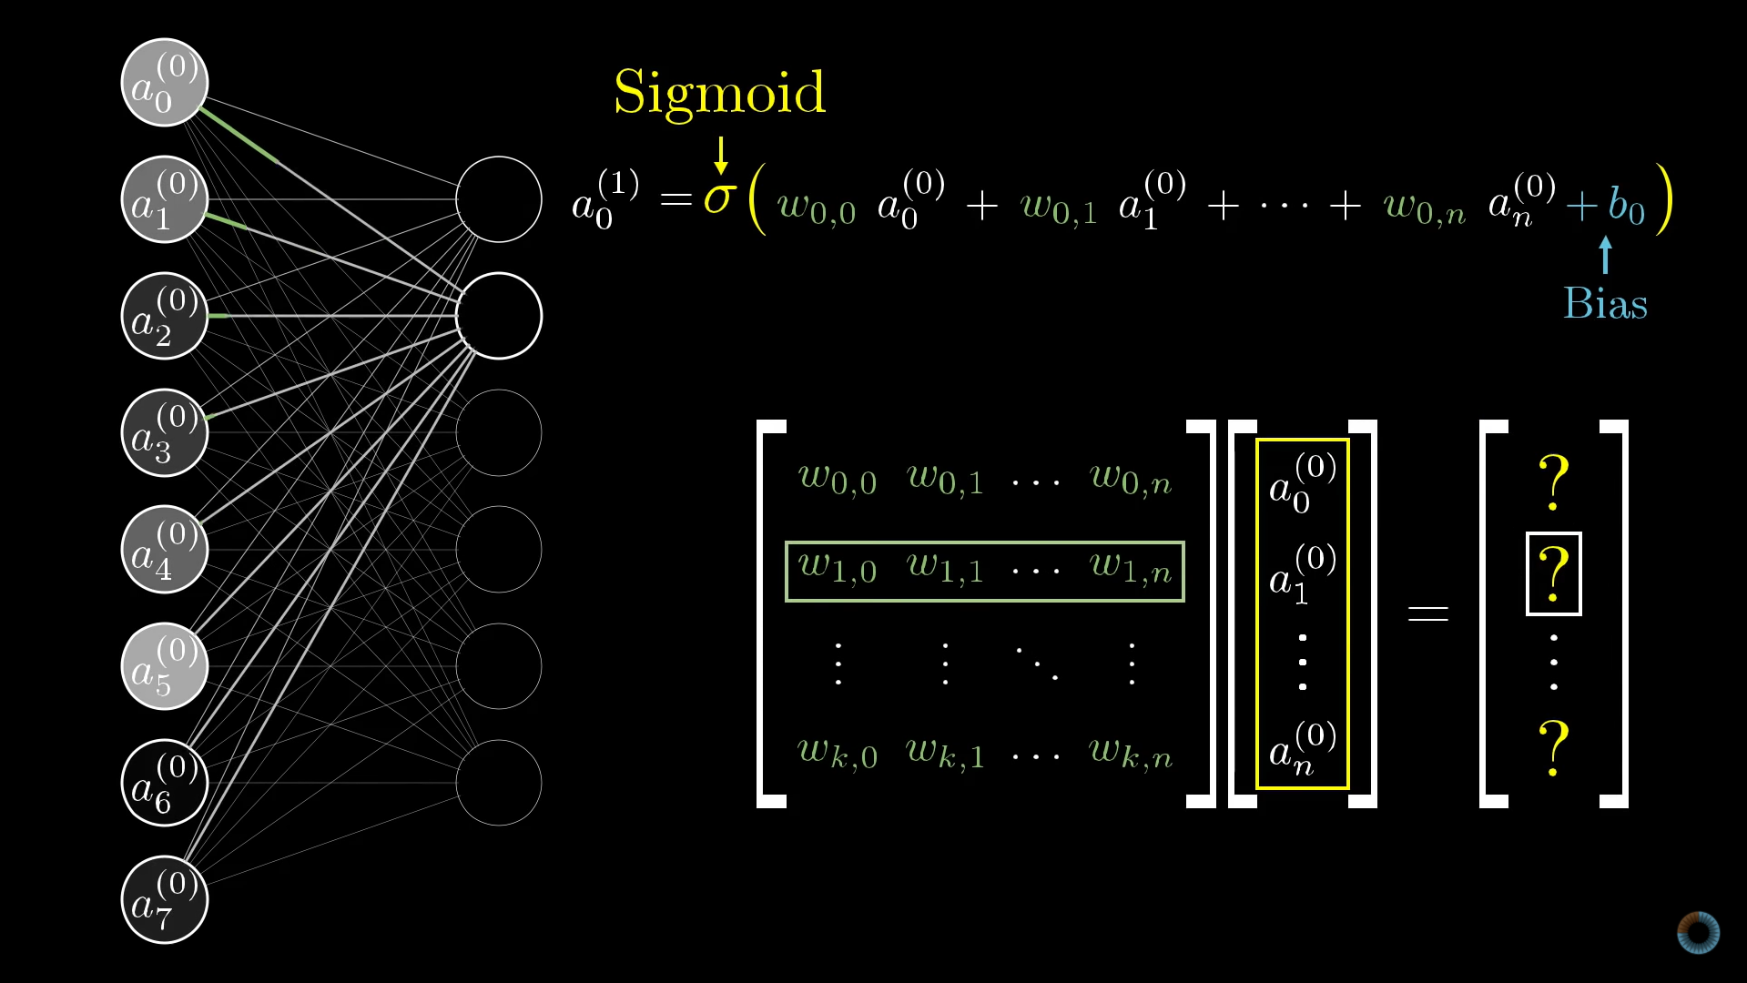

Slide 27
HANDWRITTEN DIGIT RECOGNITION USING SVM
4

Slide 28
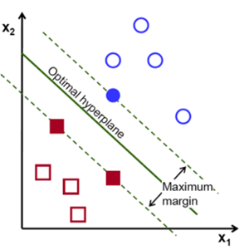
A Support Vector Machine(SVM) is a discriminative classifier which intakes training data and the algorithm outputs an optimal hyperplane which categorizes the data.
Support vectors are data points that are closer to the hyperplane and influence the position and orientation of the hyperplane. Using these support vectors, we maximize the margin of the classifier. Deleting the support vectors will change the position of the hyperplane. These are the points that help us build our SVM.

Slide 29
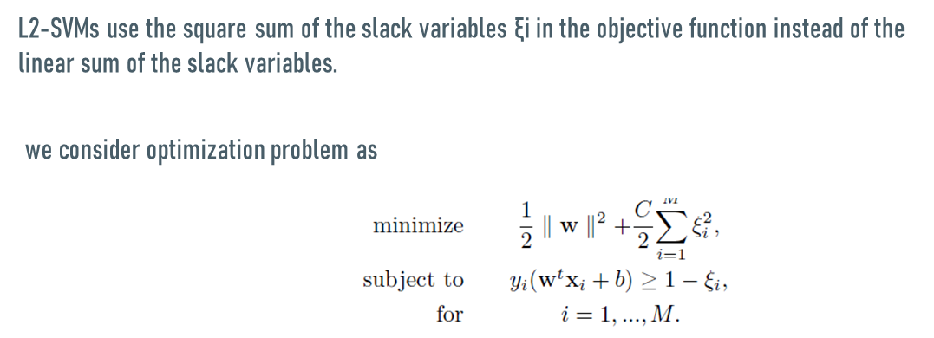

Slide 30
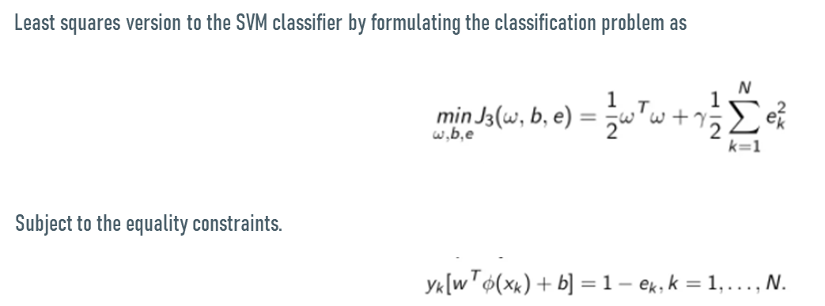

Slide 31
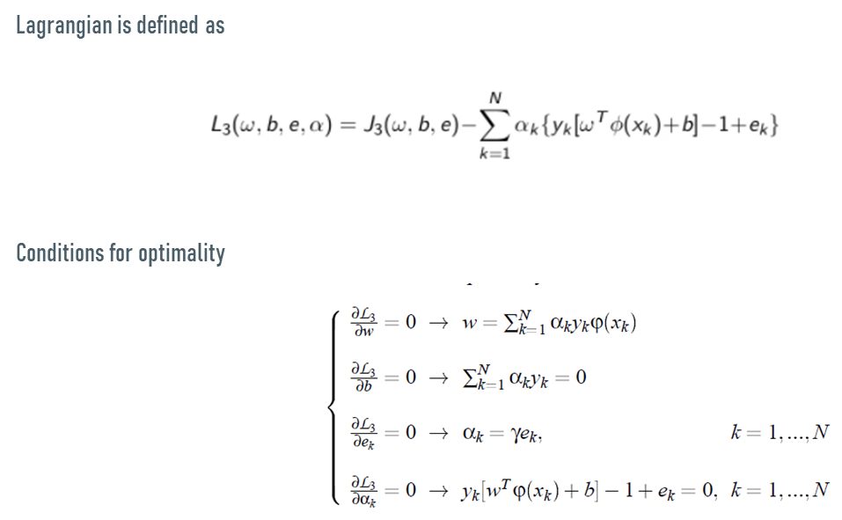

Slide 32
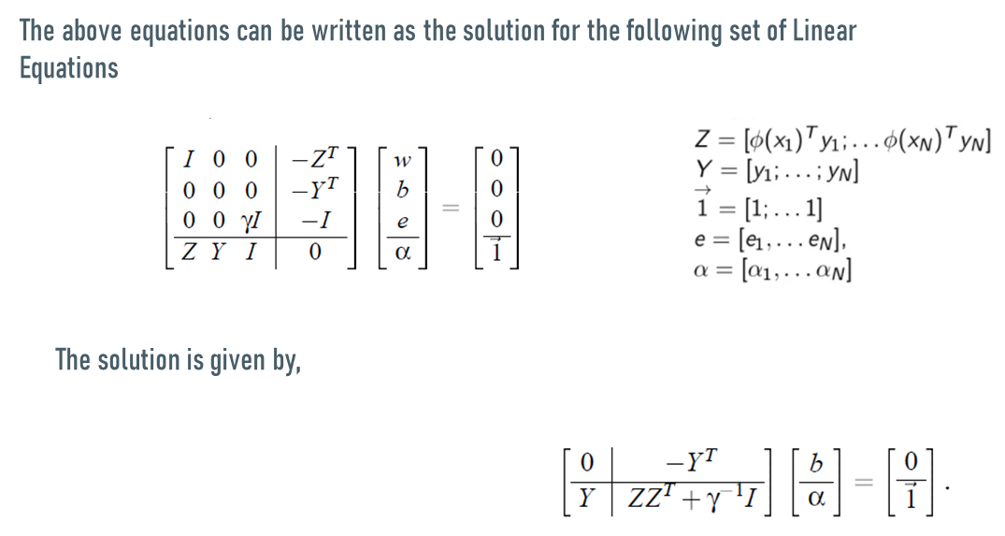

Slide 33
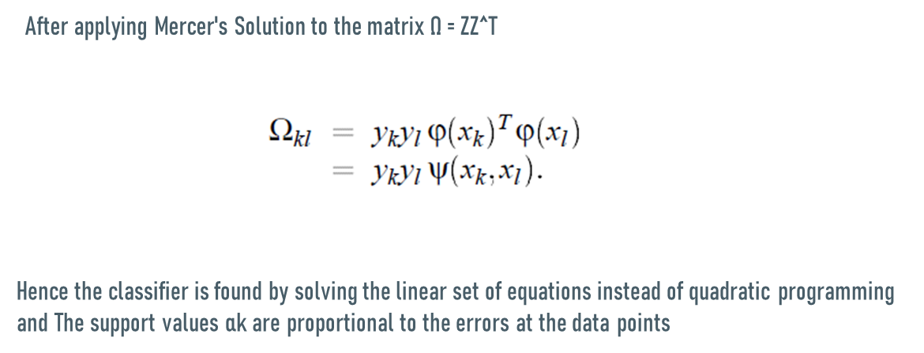

Slide 34
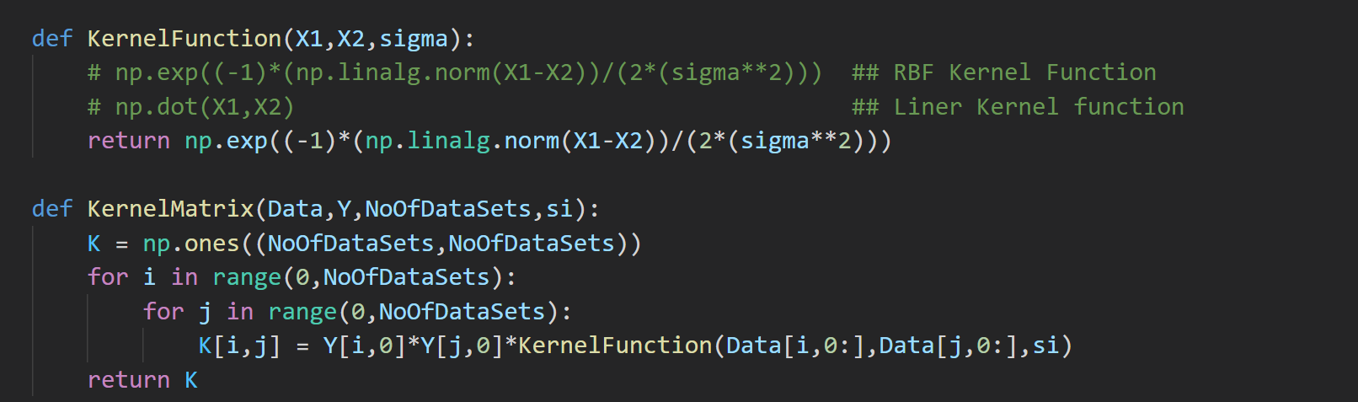

Slide 35
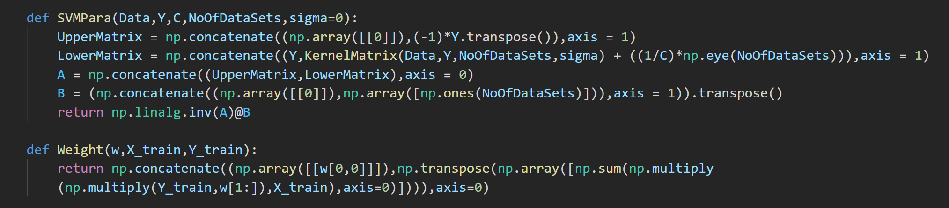

Slide 36
HANDWRITTEN DIGIT RECOGNITION USING CNN LENET-5
3

Slide 37
MNIST Dataset

Slide 38
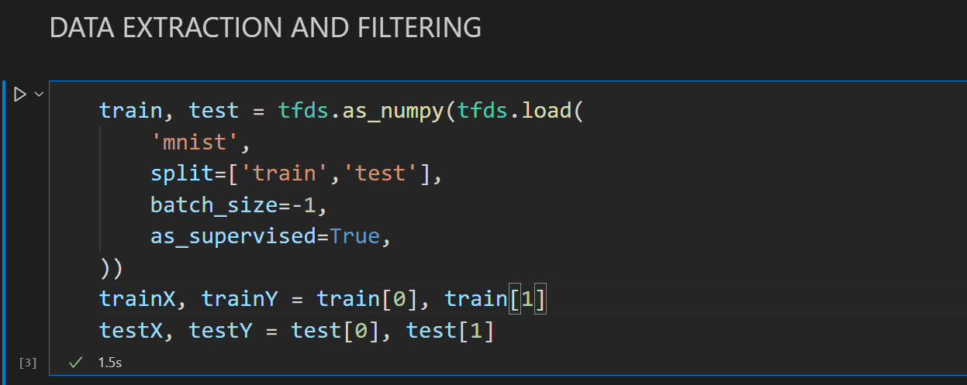

Slide 39
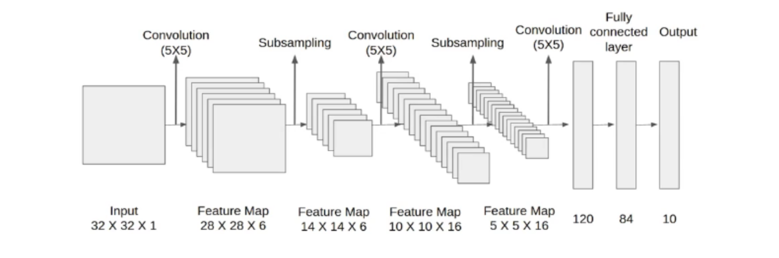

Slide 40
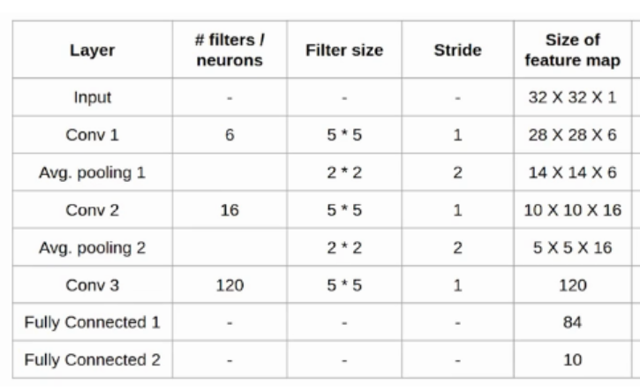

Slide 41
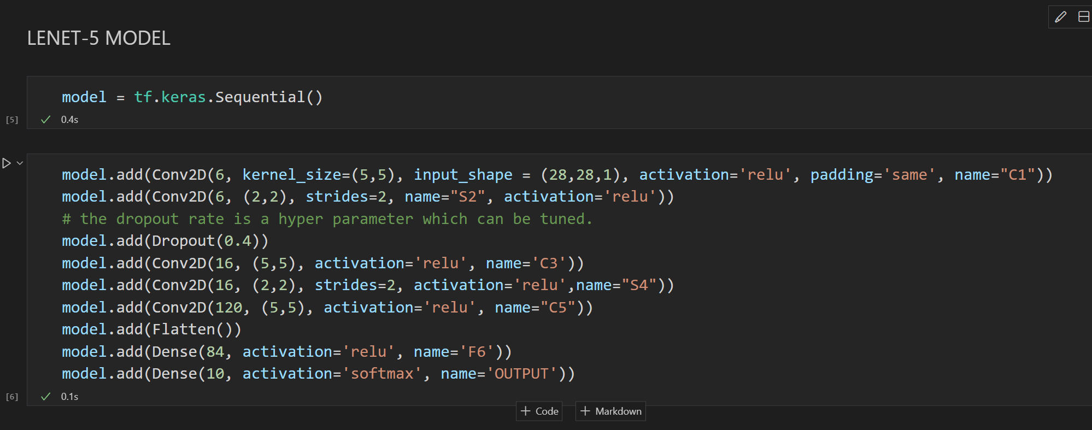

Slide 42
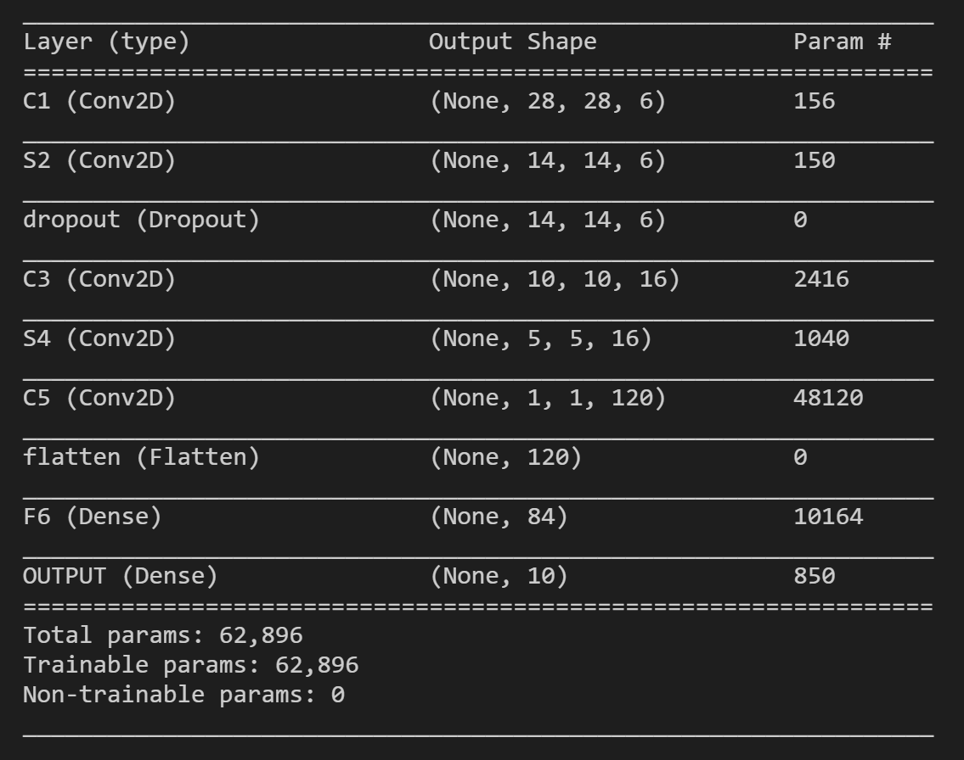

Slide 43
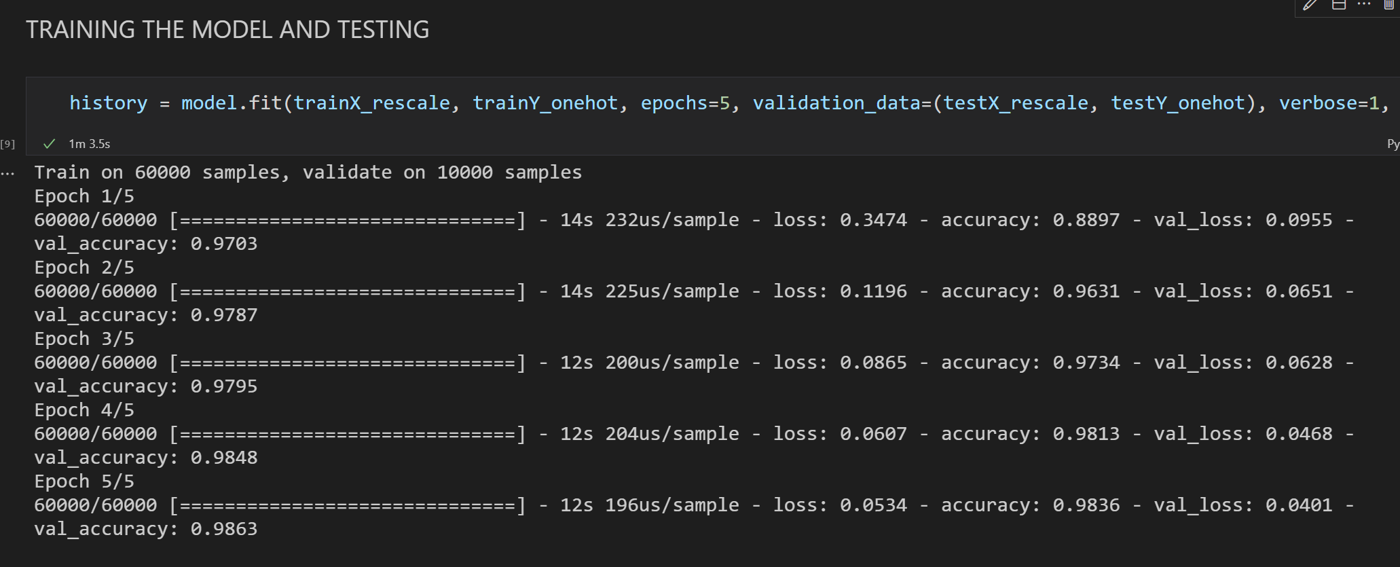

Slide 44
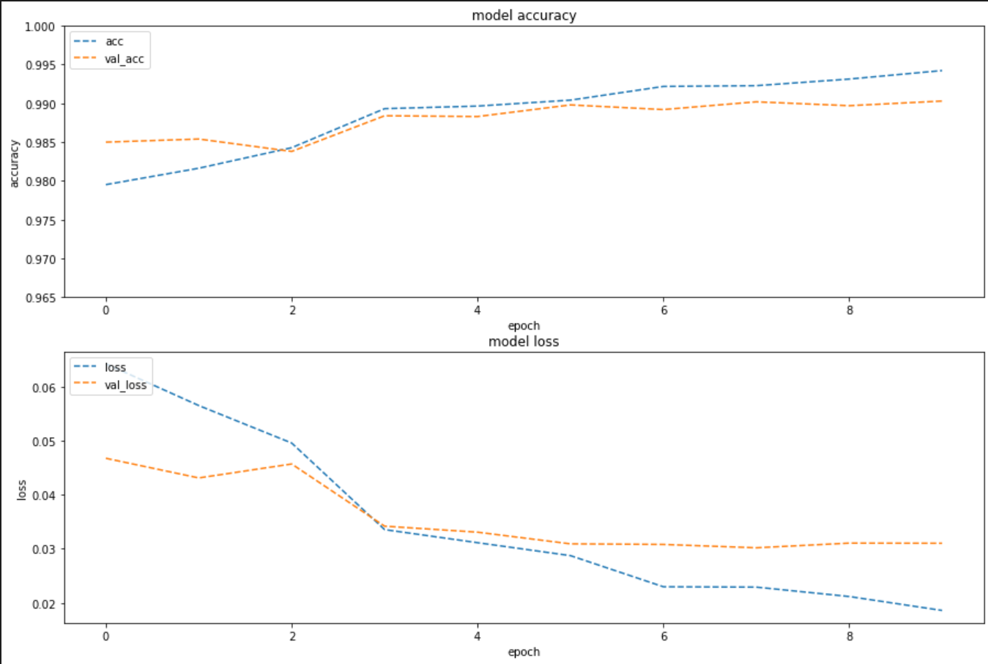

Slide 45
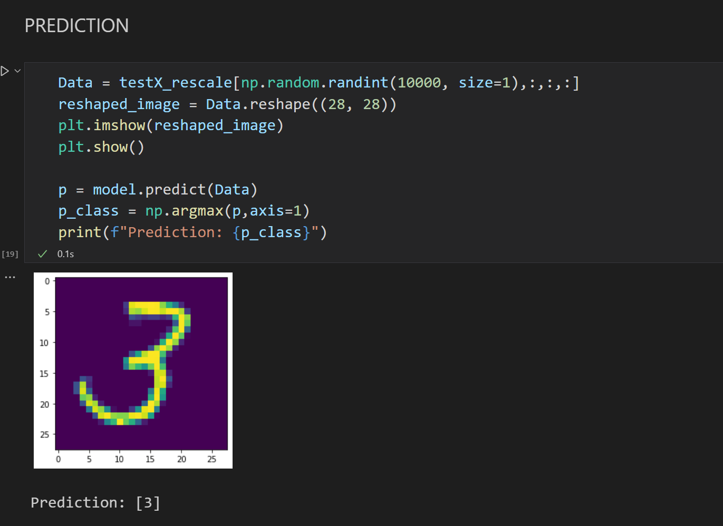

Slide 46
Accuracy
KNN – 89%
Random Forest – 90%
NN – 97.42%
CNN – 98%
SVM – 63.9% ( Average)
Hence, we can conclude that CNN is the best suitable Algorithm for handwritten digit recognition

Slide 47
THANK YOU

